Slide 1
Utica Center for Math, Science and Technology
Pathways to Success
Peter Paulon, Program Administrator
Program Overview
Q & A

Slide 2
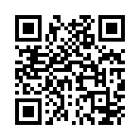
Utica Center for Mathematics, Science and Technology
Information Night
November 21, 2024
Program Overview
Classroom Visits
Sign in

Slide 3
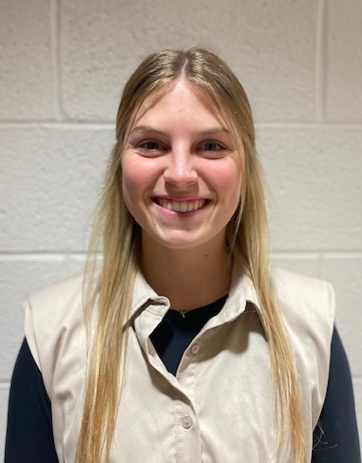
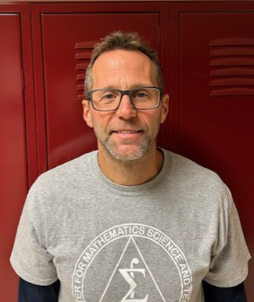
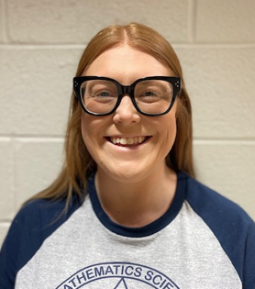
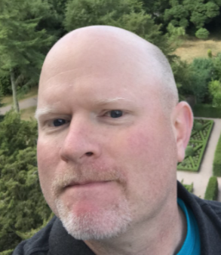
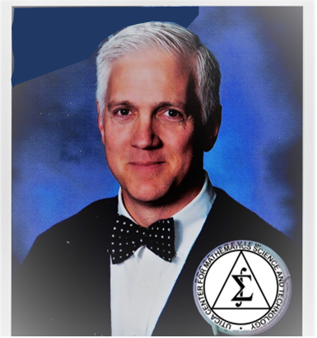
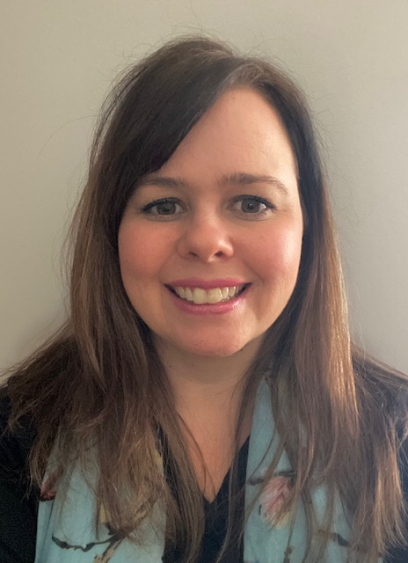
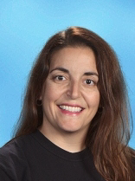
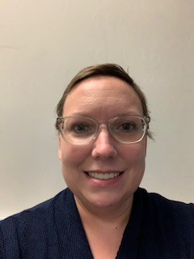
Ms. Davis
Mr. Drobnich
Ms. Kitchens
Mr. Logsdon
Mr. Luz
Mrs. Struck
Mrs. Watterson
Ms. Webb

Slide 4
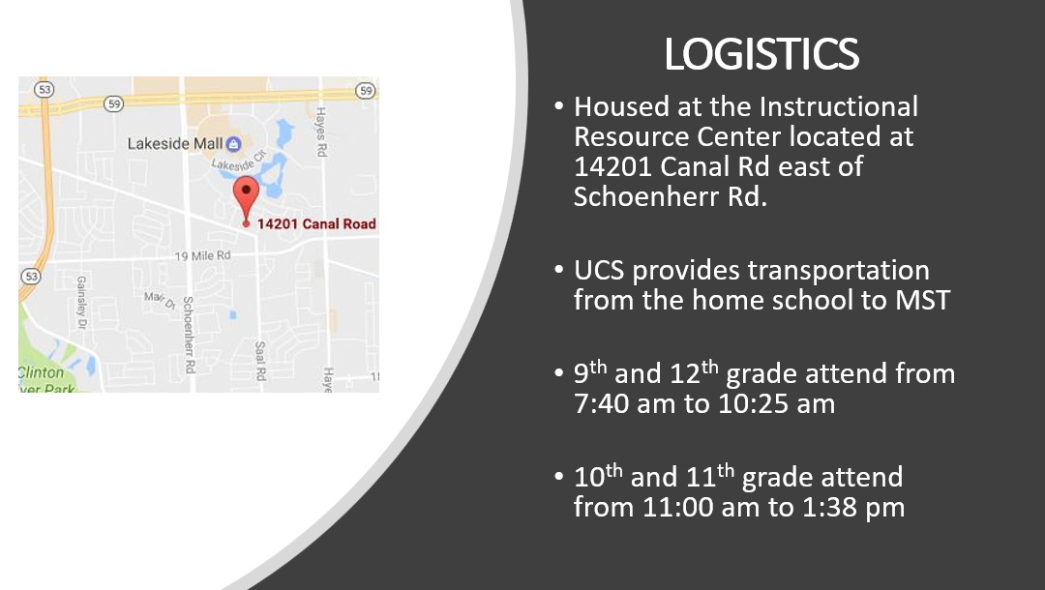

Slide 5
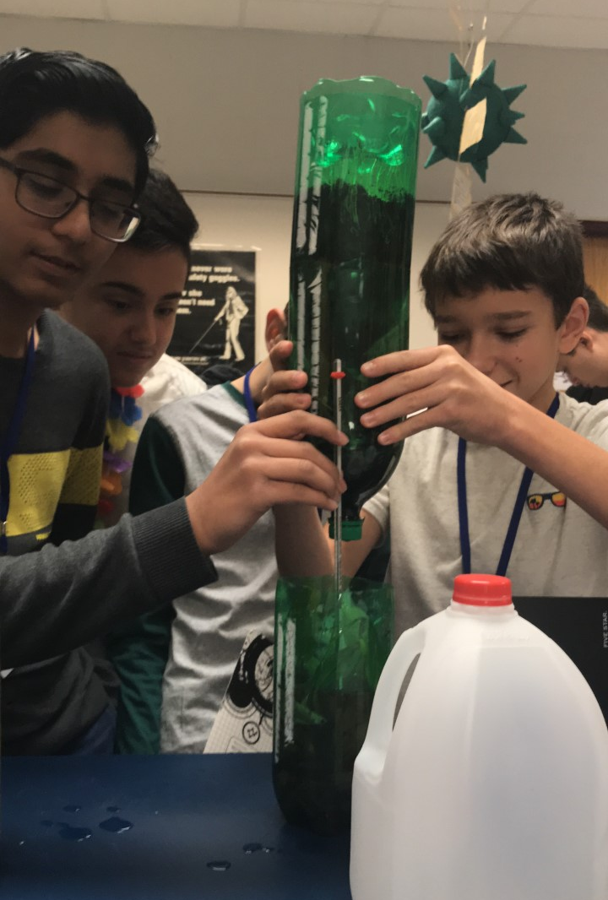
What is UCMST?
A half-day program consisting of a rigorous and integrated math, science, and computer programming curriculum

Slide 6
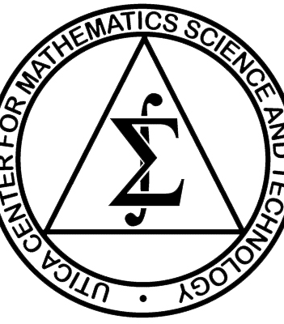
Are you the right fit for MST ?
Is MST the right fit for YOU?
Ask yourself these questions

Slide 7
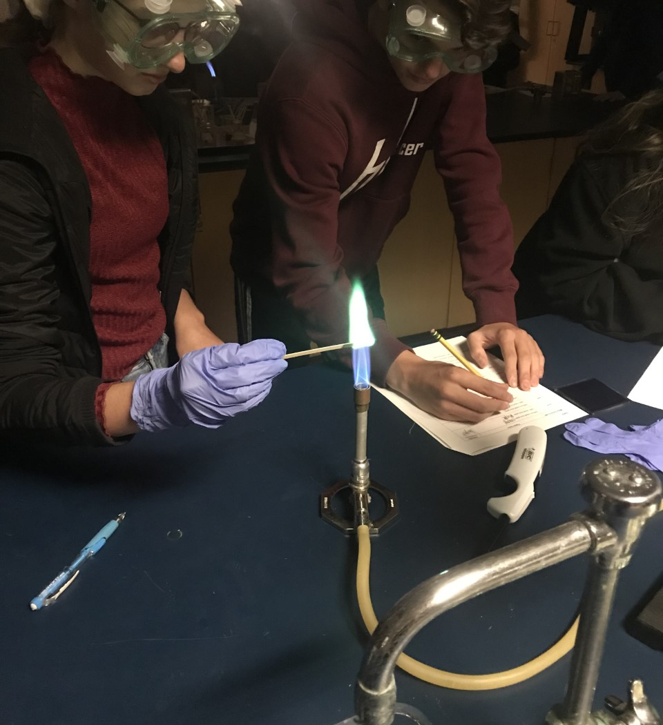
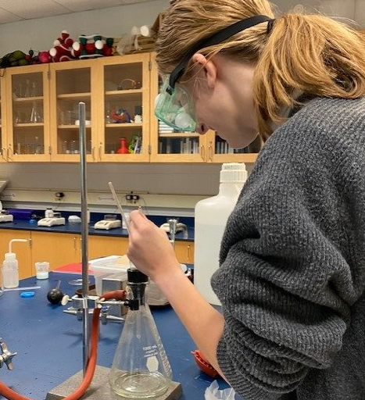
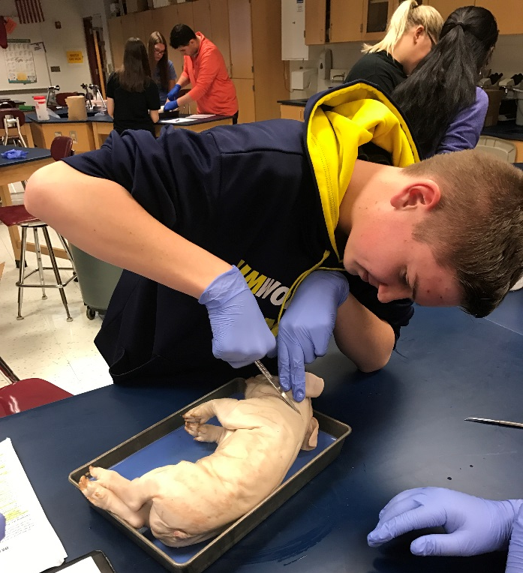
Do you like scientific investigations?

Slide 8
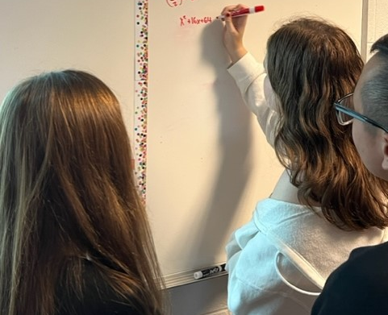
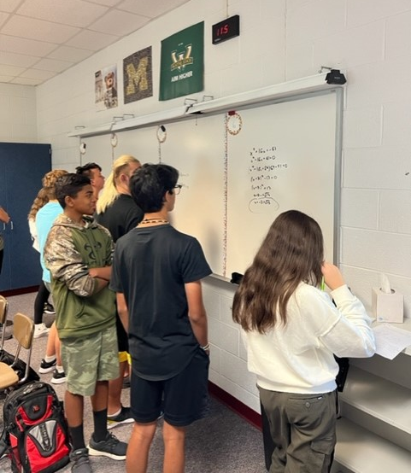
Do you want guaranteed access to the
highest-level math and science classes the
district offers?
MST Courses not Offered at Home School in 2024-2025
Eisenhower | Henry Ford II | Stevenson | Utica
Advanced Biology | Advanced Biology | Advanced Biology | Advanced Biology
Advanced Chemistry | Advanced Chemistry | Advanced Chemistry | Advanced Chemistry
Honors Physics | Honors Physics | Honors Physics | Honors Physics
AP Physics C-Mechanics | AP Chemistry | AP Physics C-Mechanics | AP Physics C-Mechanics
Foundations of Calculus | Foundations of Calculus | Foundations of Calculus | Foundations of Calculus
 |  |  | AP Computer Science A

Slide 9
9th | 10th | 11th | 12th
Advanced Algebra II with Geometry or Discrete Math | Math Analysis | AP Statistics with Foundations of Calculus | AP Calculus BC
Advanced Biology | Advanced Chemistry | AP Chemistry | AP Biology AP Physics C-Mechanics
AP Computer Science Principles | Honors Physics | Science or Math Elective* *will be unique to MST and include AP Computer Science A | Science or Math Elective* *will be unique to MST and include AP Computer Science A

Slide 10
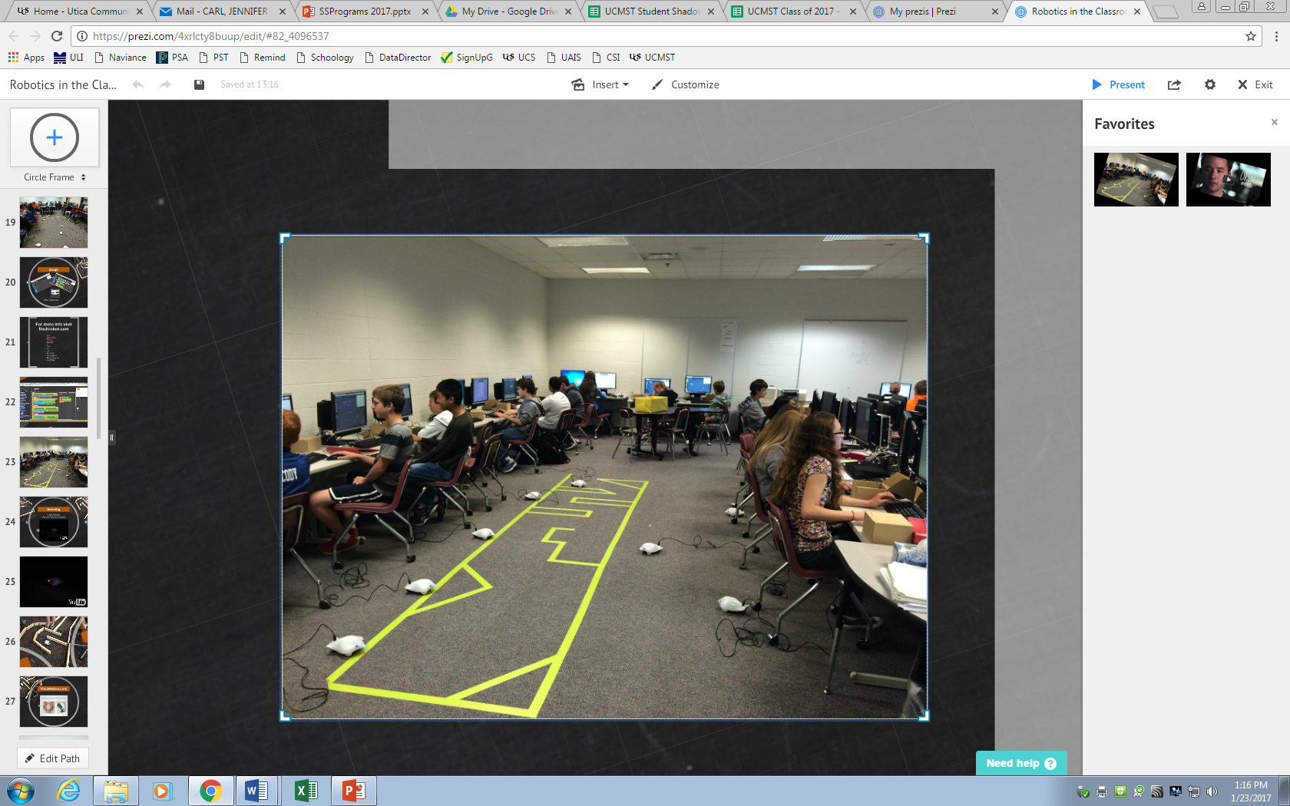
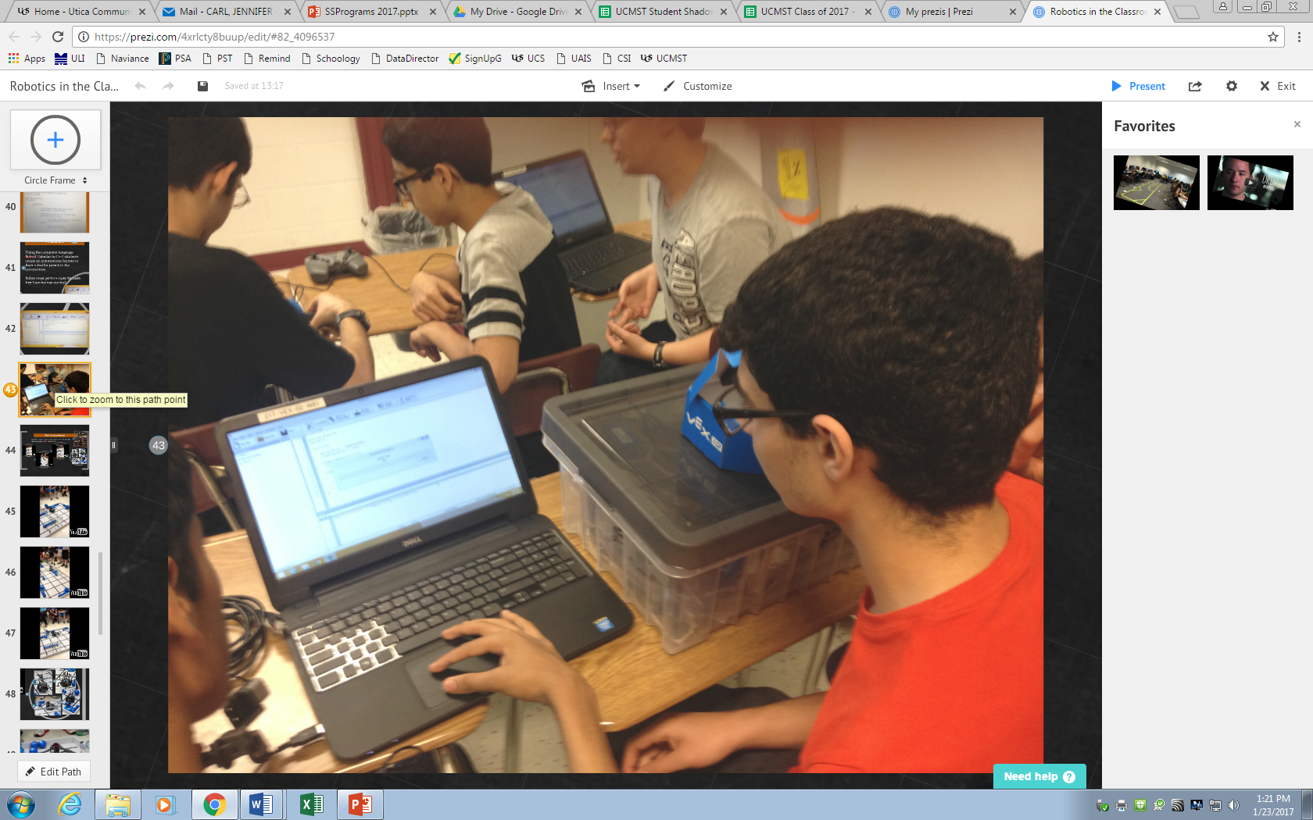
Would you enjoy learning new technologies?

Slide 11
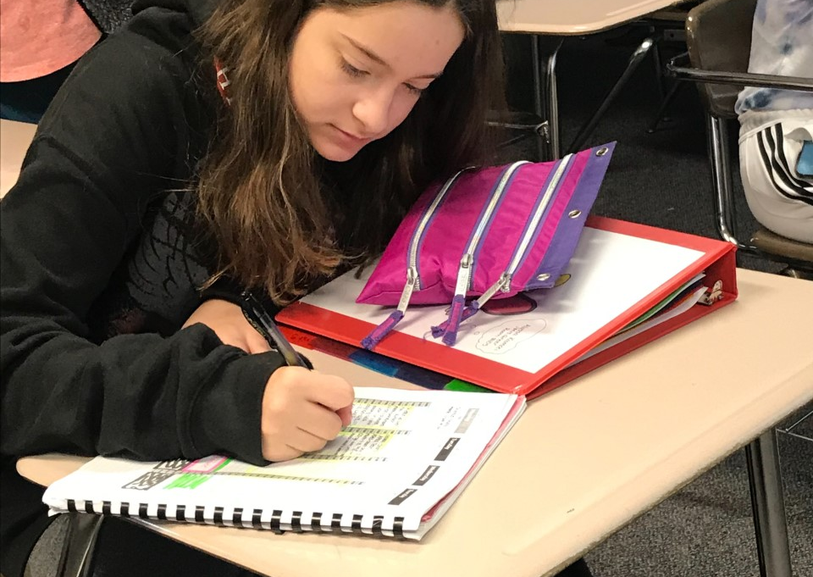
Do these statements describe you?
Good work ethic
Puts forth effort consistently
Has a growth mindset
Wants to be challenged
Passionate about learning
Dedicated
Motivated
Inquisitive
Wants to maximize advanced placement opportunities

Slide 12
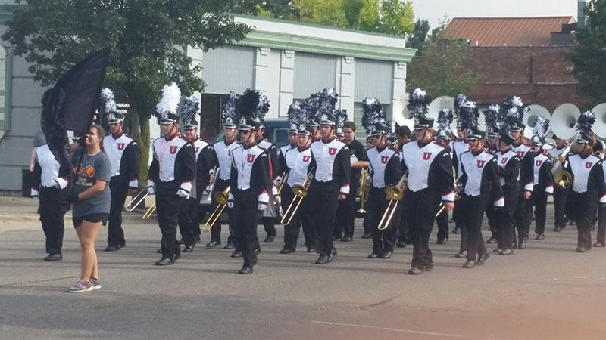
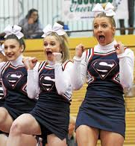
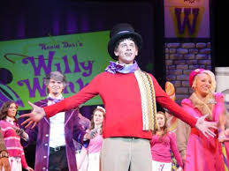
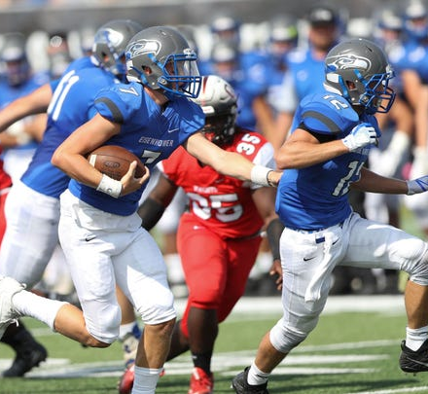
Do you desire a smaller, more individualized math and science rich environment while still connected to everything your home school offers?

Slide 13
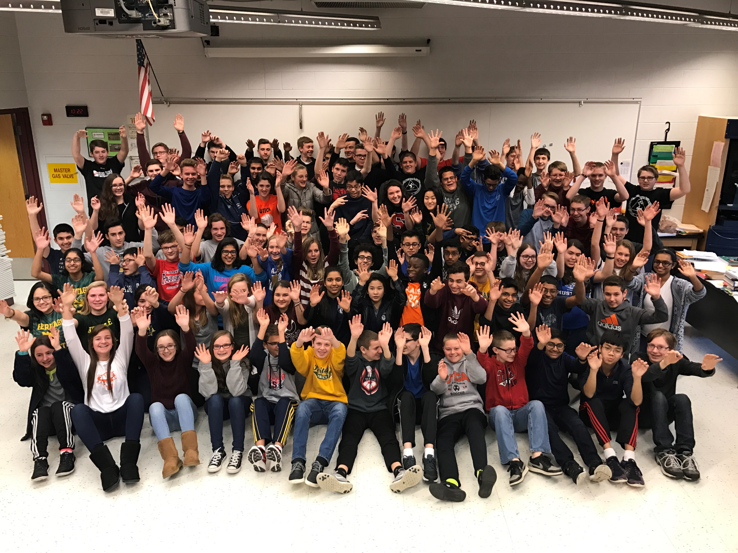
In class with like-minded students
Flexible scheduling
Unique & rigorous math, science and technology classes
Why Choose MST?
Close-knit community atmosphere

Slide 14
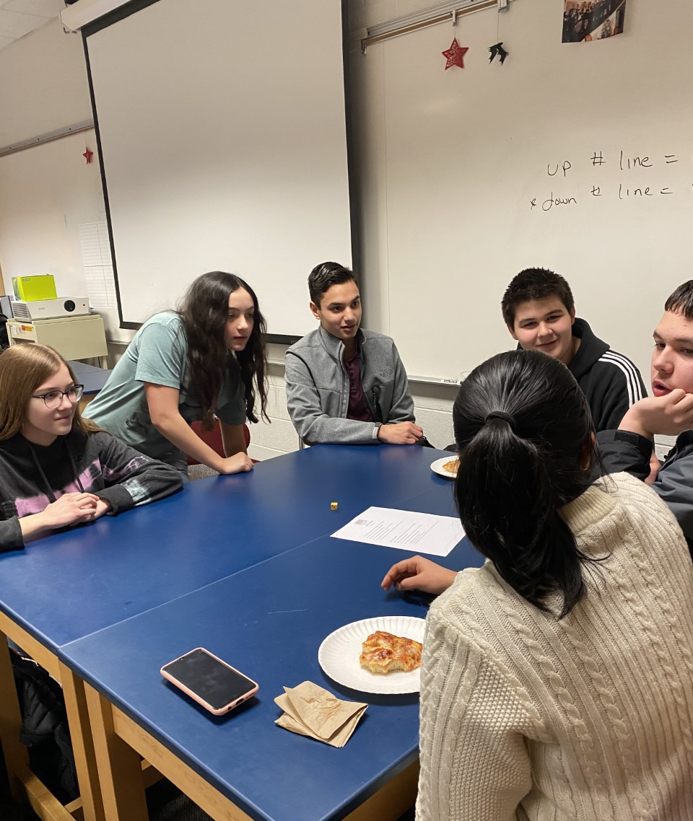
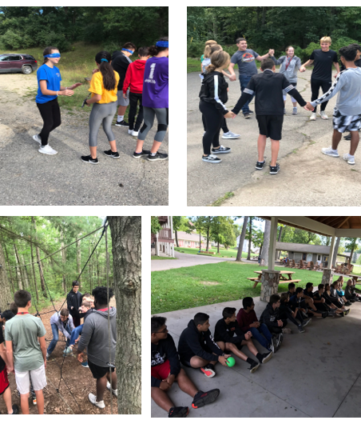
Focus on time management and organization skills using a common planner
Emphasis on cultivating positive relationships with peers and developing the community atmosphere
Individual meetings with the MST counselor during the year to determine if any additional support is needed
Counselor run classes on study skills, goal setting, wellness, time management, etc…
Freshman Support

Slide 15
MST Curriculum
Students will leave this program with:
Minimum of 6 credits in science
Minimum of 5 credits in math & computer programming
Participation in 6 or 7 Advanced Placement (AP) classes
STEM Endorsement on High School Transcript

Slide 16


Slide 17
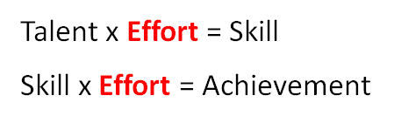

Slide 18
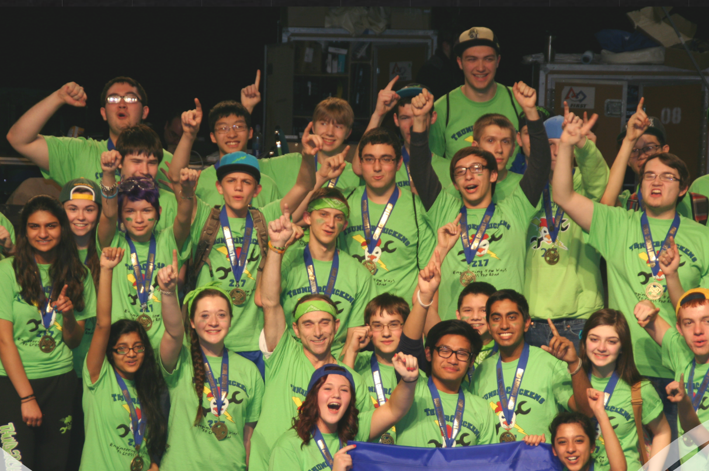
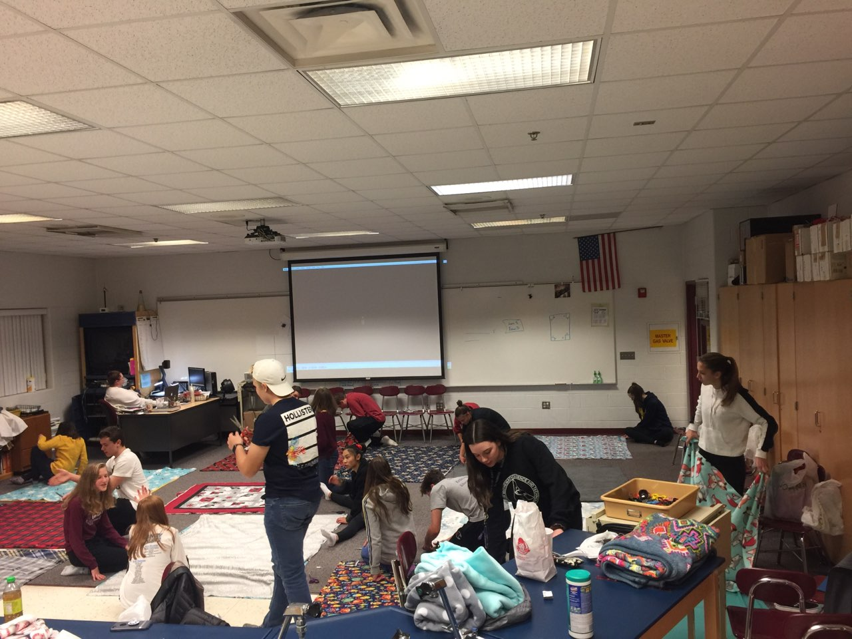
WAYS TO BE INVOLVED AT UCMST
UCMST Environmental Club
UCMST Student Council
Robotics
  ThunderChickens—3-time World Champion (2019)
  Crevolution
Do you have a vision for a club? We love new ideas!

Slide 19
SAT Composite Scores Class of 2024 | Utica Center for Math, Science and Technology Class of 2024 | Percentile Rank
Mean Composite Score (1600) | 1324 (945—MI Average) | 89th
Top 10% Mean Composite Score | 1488 | 98th
Top 25% Mean Composite Score | 1449 | 97th
Middle 50% Mean Composite Score | 1318 | 89th
Bottom 25% Mean Composite Score | 1151 | 69th
Bottom 10% Mean Composite Score | 1090 | 59th
Range | 1520—970 | 99th—36th

Slide 20
SAT Math Scores Class of 2024 | Utica Center for Math, Science and Technology Class of 2024 | Percentile Rank
Mean Math Score (800) | 690 | 90th
Top 10% Mean Math Score | 773 | 98th
Top 25% Mean Math Score | 754 | 95th
Middle 50% Mean Math Score | 693 | 91st
Bottom 25% Mean Math Score | 600 | 75th
Bottom 10% Mean Math Score | 560 | 64th
Range | 790—480 | 99th—38th

Slide 21
Valedictorians | Grade Point Average | Composite SAT Score | Difference
MST Valedictorians | 4.16 | 1376 | +180
All other UCS Valedictorians | 4.07 | 1196 | +.09

Slide 22



























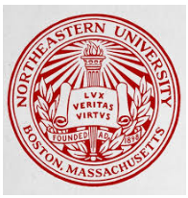






Slide 23
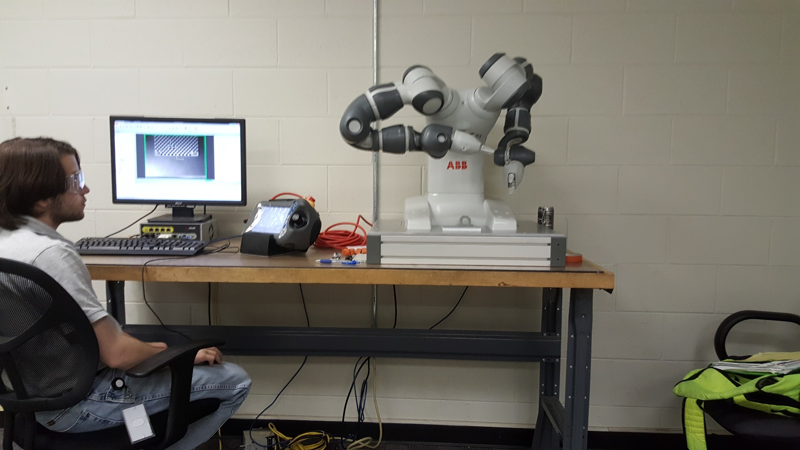
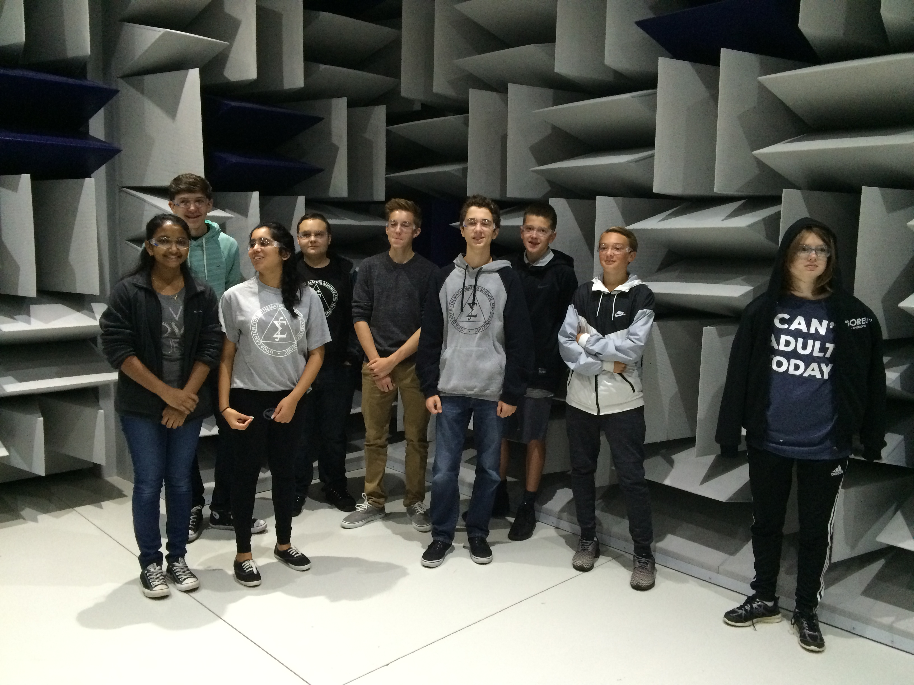
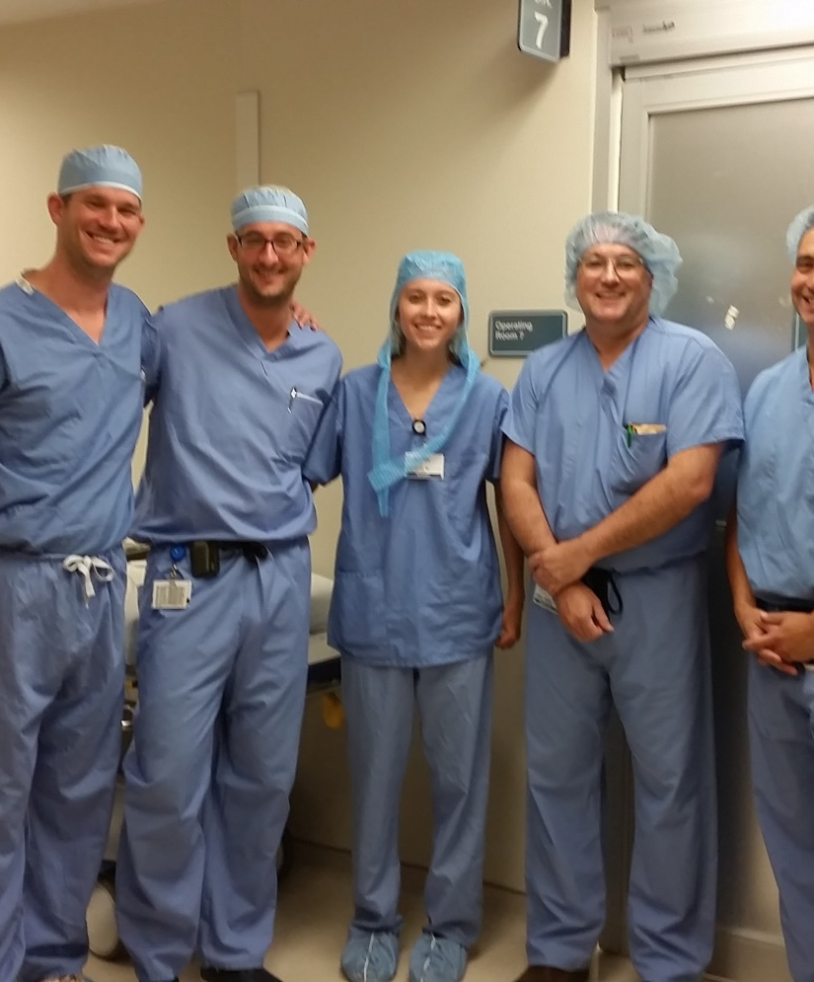
Are you considering a
career as a:
Software Engineer
Surgeon
Biostatistician
Process Development Scientist
Lawyer
Professor
Environmental Engineer
Mechanical Engineer
Chemical Engineer
Clinical Researcher
Dietitian
Graphic Designer
Architect
Financial Advisor
Cybersecurity Analyst
School Administrator
Pharmacist
Dentist
Veterinarian
Electrical Engineer
Teacher
University Admissions Director
Coast Guard Officer
Orthodontist
Software Engineer
Microbiologist
Epidemiologist
Astrophysicist
OBGYN

Slide 24

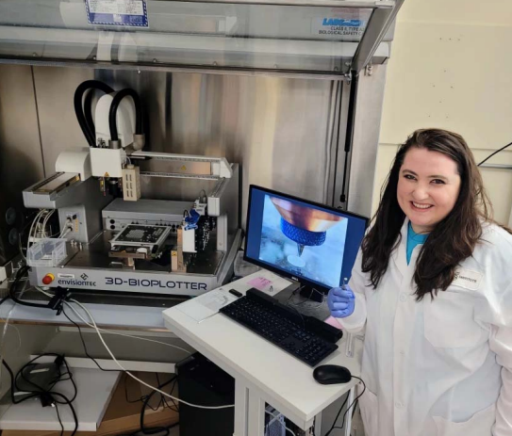
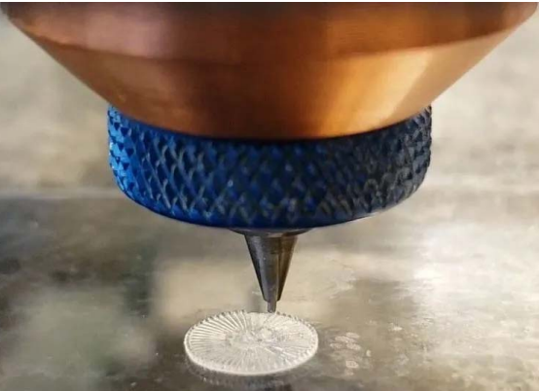
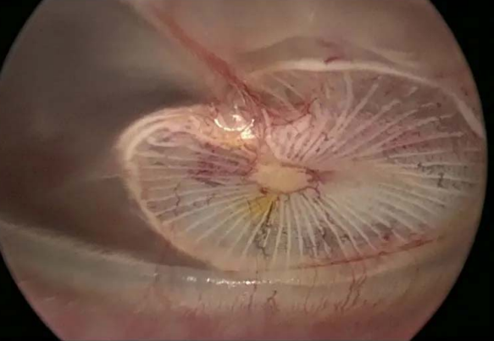
Nicole Black—2010 MST Graduate
Boston University 2014 Graduate
PhD. From Harvard University 2020
2021 Forbes 30 under 30 for Engineering and Industry
Creator of the PhonoGraft , a biodegradable 3D printed device, to repair eardrum perforations
When approved will shorten current surgical procedure from 8 hours to 20 minutes

Slide 25
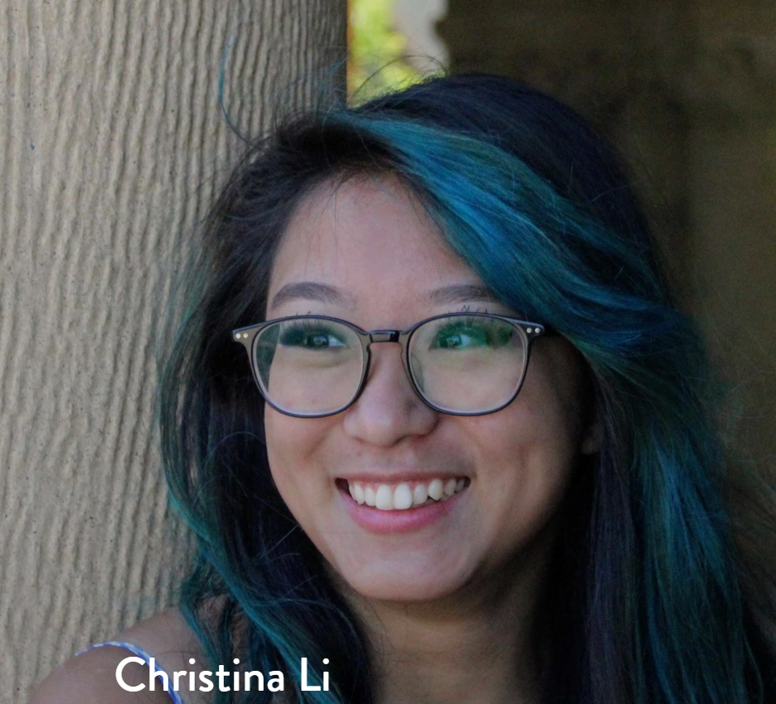
Christina Li—2016 MST Graduate
College: Stanford University (2020)
Major: Computer Science & Electrical Engineering with a minor in mechanical engineering
Propulsion Engineer on Raptor flight operations SpaceX (Starship)
Named one of 2017 CNN Young Wonders
2018 22 under 22 Most Inspiring College Women for her work in bridging the gender gap in STEM fields by empowering and encouraging girls’ interests in computer science

Slide 26
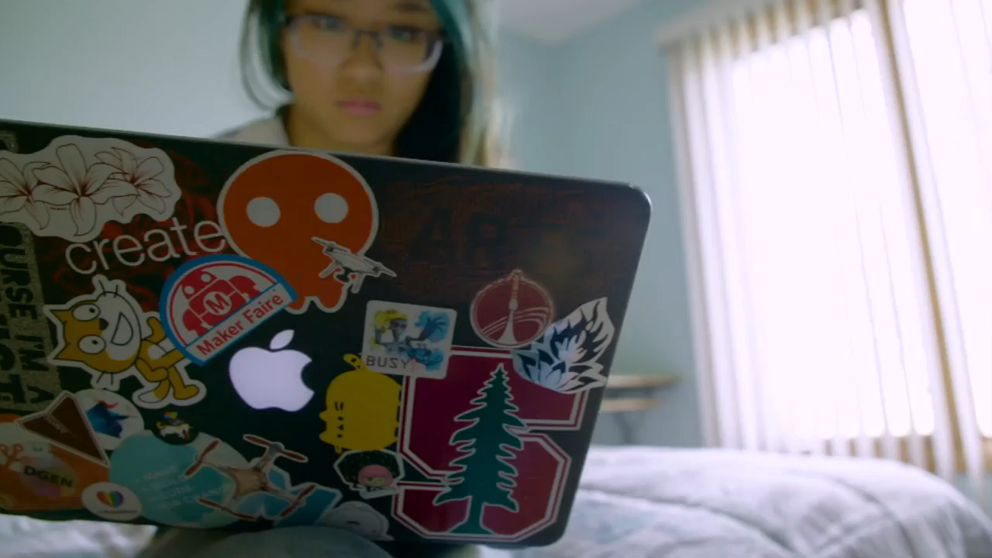

Slide 27
Candidates are qualified based on:
  Full year credit in Algebra I prior to the end of 8th grade
  Student performance on the NWEA Math and Reading assessment
  Algebra I grade
Selection Process

Slide 28
How Do I Apply to MST?
Apply on-line at uticak12.org/academics/specialtyprograms
  Application is open from - Friday, December 6, 2024 at 4:00 pm through Friday, December 20, 2024 at 4:00 pm
  Apply for at most two UCS Specialty Programs (UCMST, UCSI, UHHS, GLKUAIS, and Stevenson MADE)
Carefully consider which program is your first choice
Incomplete or late applications will not be accepted

Slide 29
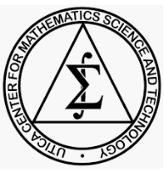


ucmst
Utica Center for Math, Science and Technology

